Slide 1
Impact of Internet Usage
· Davin Frankosky
· George Liberatos
· Alison Love
· Haylee McLean
· Quentin O’Neal
· Tia Scott

Slide 2

Project Outline
In the era of digital transformation, the internet has become an integral part of our daily lives, influencing how we communicate, work, learn, and entertain ourselves. The vast expanse of the digital landscape offers a rich tapestry of data, providing an opportunity to unravel the intricate patterns of internet usage across different regions, demographics, technology, and disparities of information.
This project aims to delve into the multifaceted aspects of internet usage, leveraging data analytics to gain insights into users of the internet, technological trends, and censorship of global connectivity.

Slide 3

Research Questions
Question 1
Who is using the internet?
What is the average gender, income, and educational level?
Are there disparities between any demographics?
Question 2
What is the breakdown of Internet Usage?
What is more predominate, broadband or mobile use?
Does adoption of mobile affect broadband usage?
Question 3
Who is censoring the internet?
Who is censoring the internet to users?
Who is affected by internet censorship?

Slide 4
UPDATE
FLAAAAAMES
Step 1. Data Collection

Slide 5

Timeline
CSV RESOURCES
API RESOURCES
MERGE
FILE CREATION
Identify and collect data from CSV’s
Identify and collect data from CSV’s
Merge data into master dataframes
Create files with merged data
Intake
Cleaning
Join
Explore
CONVERT
REFINE
EXPLORE
Normalize data
into usable
datasets
Fill NaN’s, empty data, parse bad data
Test relationships, theories, and create compelling visuals
Notes:
Cross-section between Tech and Ops

Slide 6
Step 2. Data Analysis

Slide 7
Impact of Internet Demographics
· Alison Love
· Quentin O’Neal

Slide 8
Research Questions
Question 1
Who is using the internet?
What is the average age, race, gender, and educational level?
Are there disparities between any demographics?

Slide 9
Global Internet Usage by Country / Heatmap
UPDATE
Gender Gap by country heatmap

Slide 10
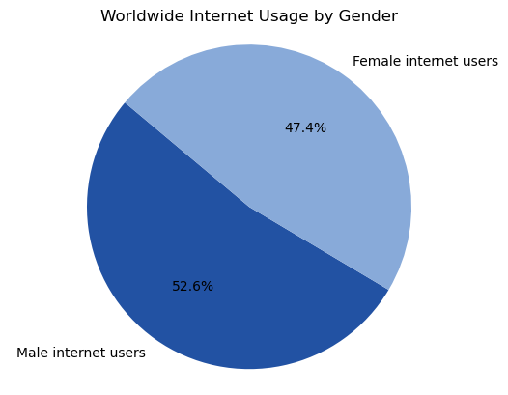
Internet Access - Gender
UPDATE
Worldwide Internet Usage – By Gender
SUMMARY HERE

Slide 11
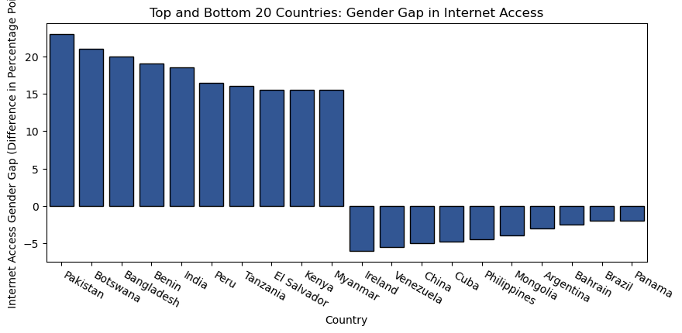
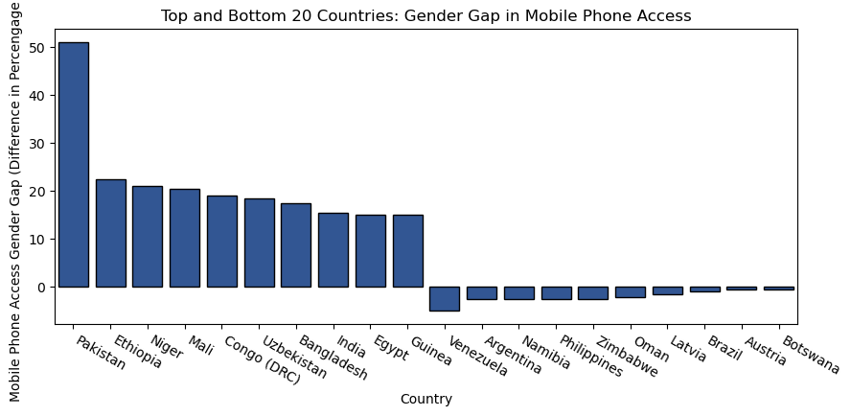
Internet Access - Gender Gaps
Gender Gap in Internet Access
SUMMARY HERE
Gender Gap in Mobile Access
SUMMARY HERE

Slide 12
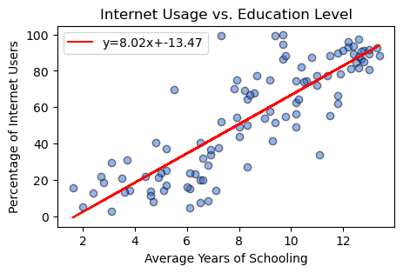
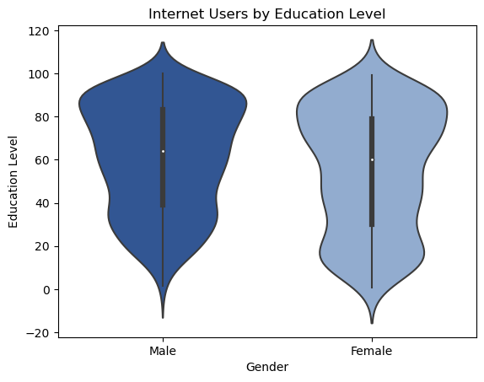
Internet Access – Education Level
Internet Usage and Education Level
SUMMARY HERE
Internet Users by Education Level
SUMMARY HERE
UPDATE

Slide 13
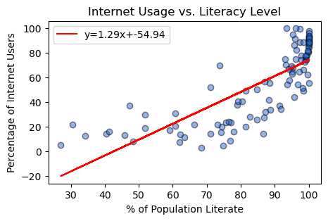
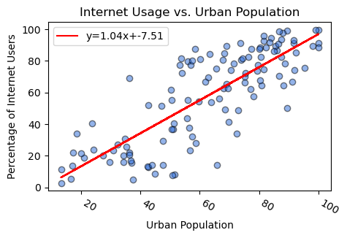
Internet Access – Literacy & Urban Population
Internet Usage and Literacy Levels
SUMMARY HERE
Internet Usage and Urban Populations
SUMMARY HERE

Slide 14
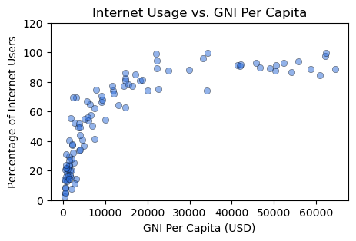
Internet Access – Gross National Income
Internet Usage and Gross National Income
SUMMARY HERE

Slide 15
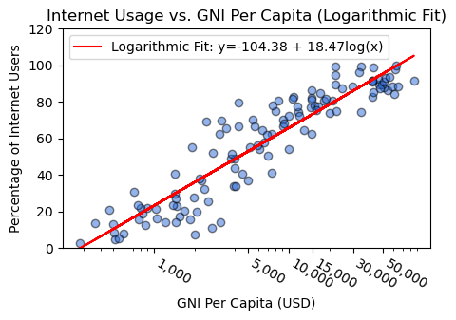
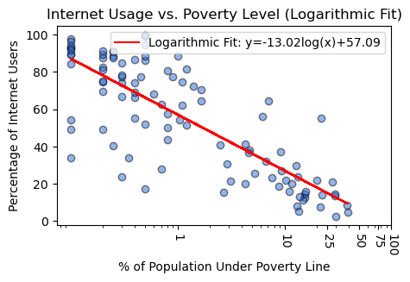
Internet Access Logarithmic
Internet Usage and Gross National Income (LOG)
SUMMARY HERE
20 Tech SLA’s Missed Performance Standard
Change Deployment Activities 85%
Application Code Change Related – 24%

Slide 16
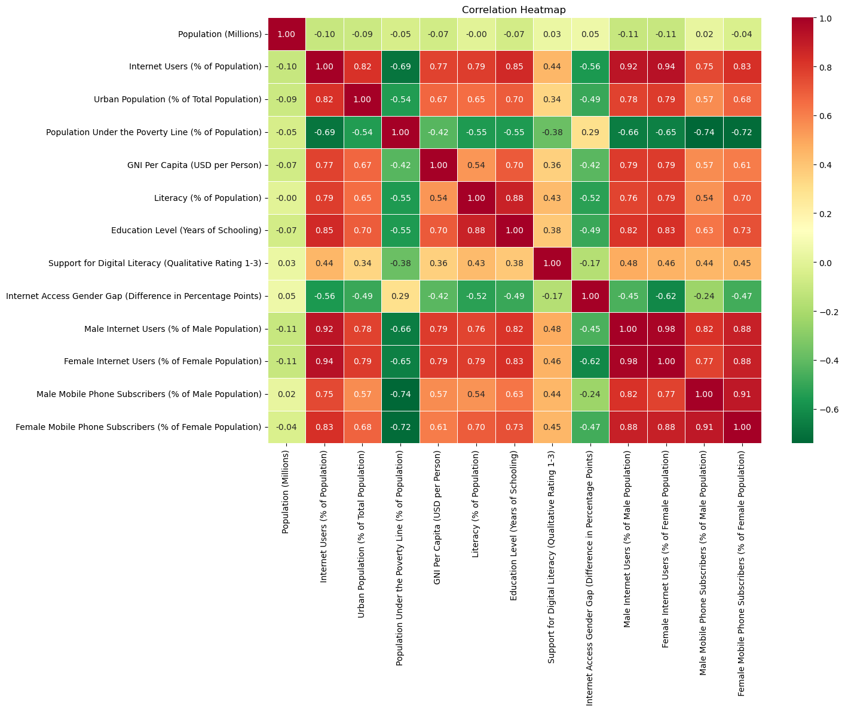
Internet Access – ??
UPDATE
Internet Usage and Gross National Income (LOG)
SUMMARY HERE

Slide 17
Impact of Internet Technology
Broadband V. Mobile
· Davin Frankosky
· Tia Scott

Slide 18
Research Questions
Question 2
What is the breakdown of Internet Usage?
What is more predominate, broadband or mobile use?
What are the factoring disparities between broadband or mobile use?

Slide 19
Broadband v. Mobile - Heatmap
UPDATE
Broadband and Mobile Heatmap

Slide 20
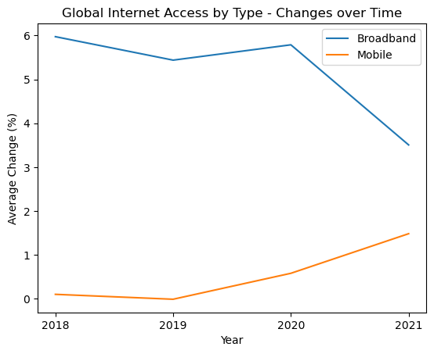
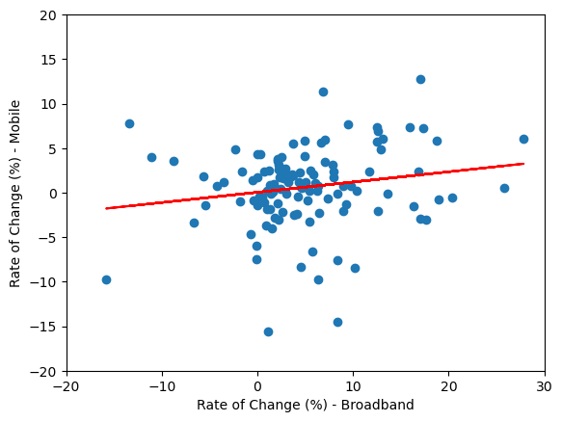
Broadband v. Mobile – Change Over Time
Broadband and Mobile Change Over Time
SUMMARY HERE
UPDATE
Broadband and Mobile Change Over Time
SUMMARY HERE
UPDATE

Slide 21
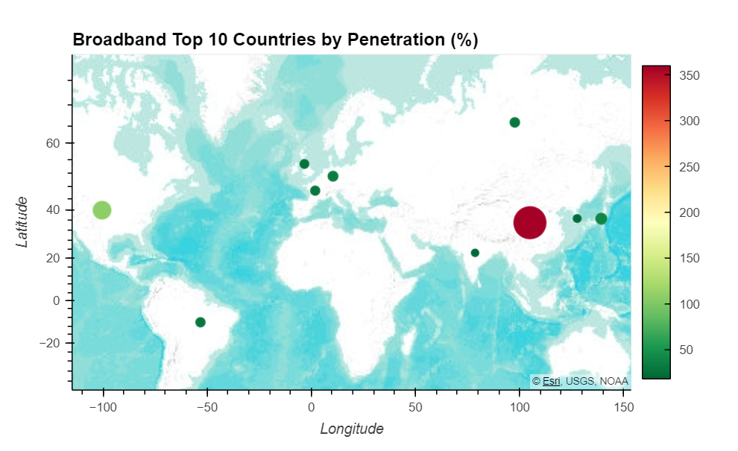
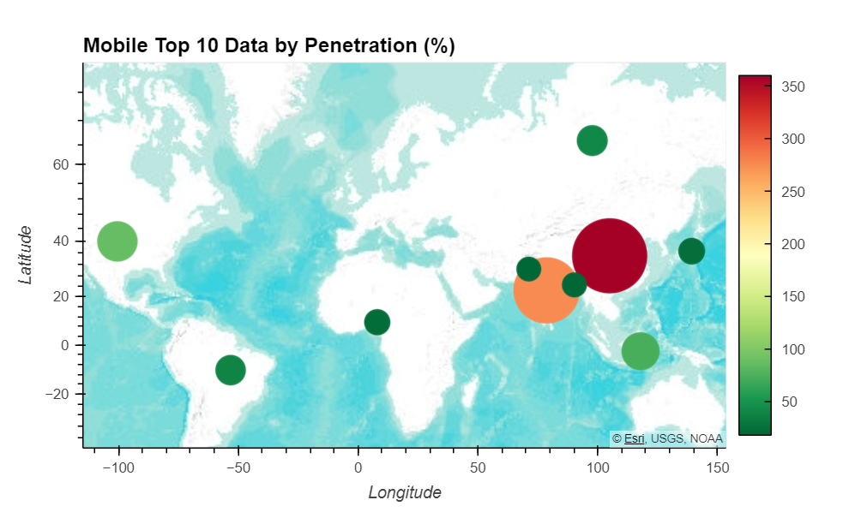
Broadband v. Mobile – Top 10 Countries
Broadband Top 10 Countries
SUMMARY HERE
Mobile Top 10 Countries
SUMMARY HERE

Slide 22
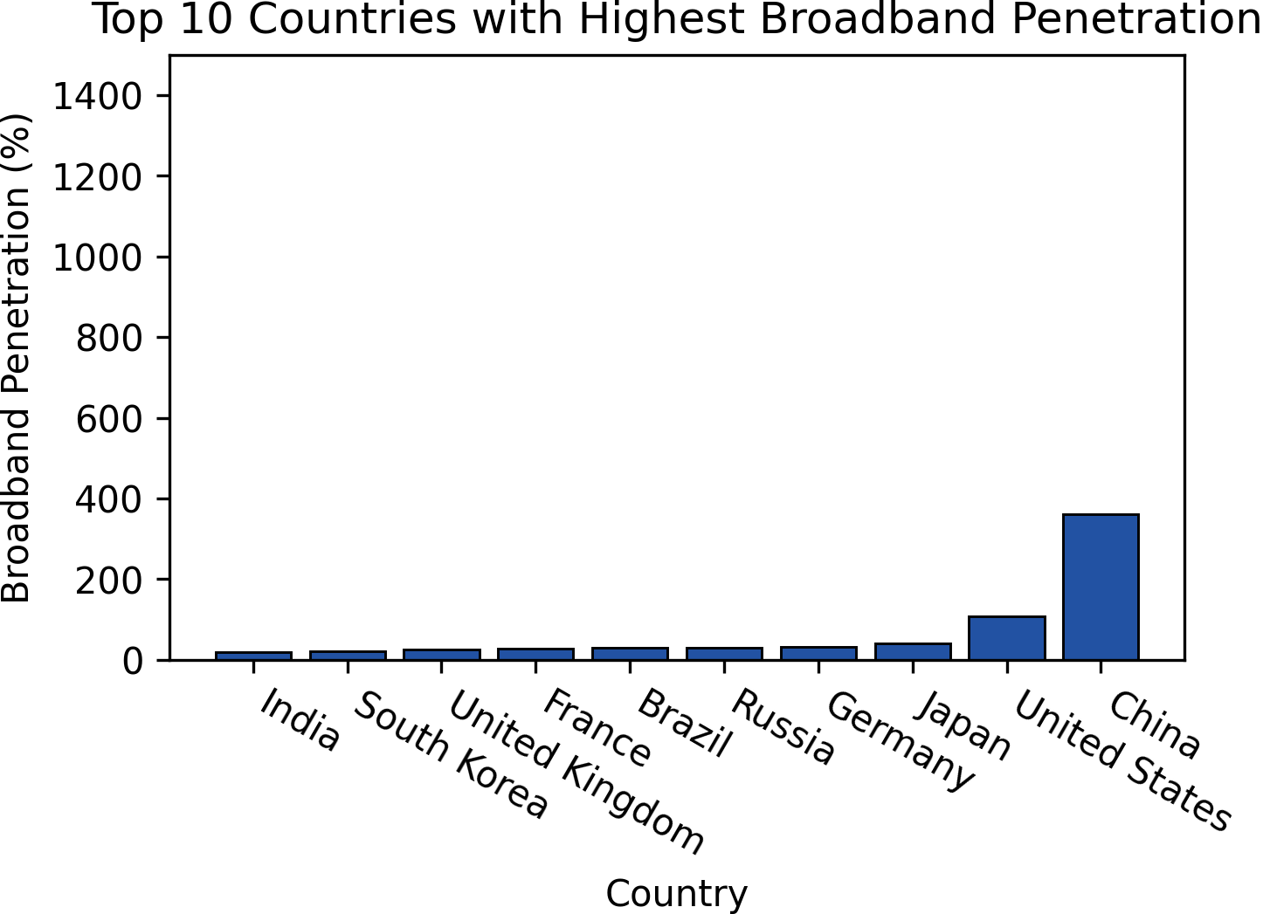
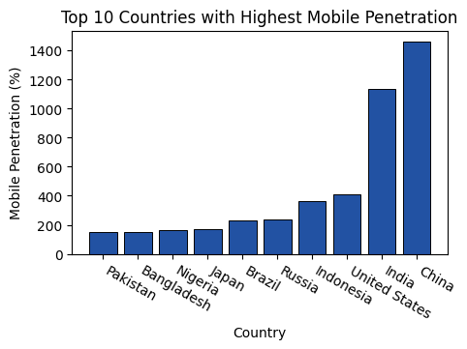
Broadband v. Mobile – Top 10 Countries
Broadband Top 10 Countries
SUMMARY HERE
Mobile Top 10 Countries
SUMMARY HERE

Slide 23
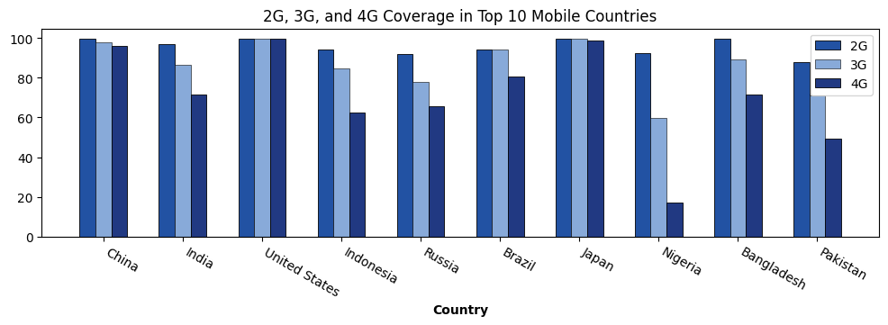
Broadband v. Mobile – Coverage
2G, 3G, and 4G Coverage in the Top 10 Mobile Countries
SUMMARY HERE

Slide 24
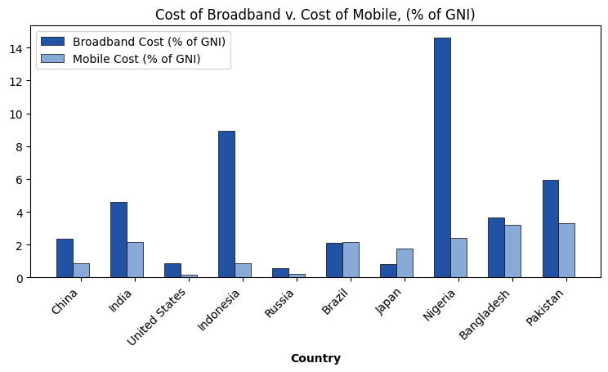
Broadband v. Mobile – Cost Comparison
Cost of Broadband and Mobile in the Top 10 Countries
SUMMARY HERE

Slide 25
Impact of Internet Censorship
· George Liberatos
· Haylee McLean

Slide 26
Research Questions
Question 3
Who is censoring the internet?
Who is censoring the internet to users?
Does censorship have any adverse effects?

Slide 27
Internet Censorship - Heatmap
CENSORED IMAGE
Censorship Heatmap

Slide 28
Internet Censorship - Heatmap
UPDATE
Censorship Heatmap

Slide 29
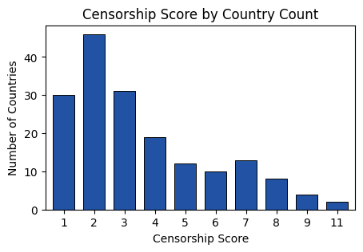
Internet Censorship – Score and Population
Censorship Score by Country
SUMMARY HERE

Slide 30
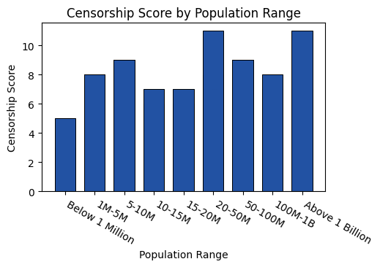
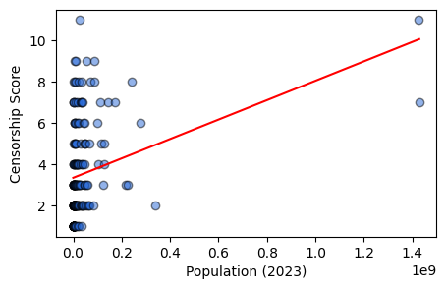
Internet Censorship – Score and Population
UPDATE
Censorship Score by Population
SUMMARY HERE
Censorship Score by Population
SUMMARY HERE

Slide 31
Step 3. Conclusion

Slide 32

Conclusions
QUESTION | SHORT ANALYSIS | STATUS
Capital Markets Strategic Initiatives | Comment Comment | 
Investment In Syndicated loans | Comment | 
Treasury Management Stability Program | Comment | 
INTERNET DEMOGRAPHICS
QUESTION | SHORT ANALYSIS | STATUS
Capital Markets Strategic Initiatives | Comment Comment | 
Investment In Syndicated loans | Comment | 
Treasury Management Stability Program | Comment | 
BROADBAND V. MOBILE
QUESTION | SHORT ANALYSIS | STATUS
Capital Markets Strategic Initiatives | Comment Comment | 
Investment In Syndicated loans | Comment | 
Treasury Management Stability Program | Comment | 
INTERNET CENSORSHIP

Slide 33
Resources

Slide 34
Data Sources
Kaggle
Internet Usage – History of Internet and Evolution of Broadband
https://www.kaggle.com/datasets/pavan9065/internet-usage?select=broadband-penetration-by-country.csvSub Bullet
Comparitech
Internet Censorship 2023: A Global Map of Internet Restrictions
https://www.comparitech.com/blog/vpn-privacy/internet-censorship-map/
United Nations
Department of Economic and Social Affairs : Population Division
https://population.un.org/wpp/
GeoAPIfy
GeoAPIfy – Location API
https://www.geoapify.com/
General
https://chat.openai.com/
https://geekforgeeks.com/
https://stackoverflow.com/

Slide 36
Color Palette
The color palette is a guide for maintaining consistency across various documents and this template. If your computer does not support the Color Theme, please refer to the following color guide.
Text Colors
Plot Colors
Status Colors
Other Colors
Sub Headings
Scatter Plot
Green Status
Third Blue
R: 12 G: 32 B: 116
#0C2074
R: 217 G: 217 B: 217
#2869D7
R: 51 G: 153 B: 51
#339933
R: 163 G: 224 B: 255
#A3E0FF
Main Headings
Box Plot
Yellow Status
Orange
R: 43 G: 133 B: 187
#2B85BB
R: 166 G: 166 B: 166
#2252A3
R: 255 G: 204 B: 0
#FFCC00
R: 255 G: 140 B: 25
#FF8C19
Table Heading and Main Text
Red Status
Purple
R: 204 G: 0 B: 0
#CC0000
R: 102 G: 0 B: 102
#660066
R: 113 G: 113 B: 113
#717171

Slide 37
Financial Plan Risks and Watch Items
Identified Risks
Bullet
Bullet
Sub Bullet
Sub Bullet
Bullet
Sub Bullet
Sub Bullet Highlight
Items to Watch
Bullet
Bullet
Sub Bullet
Sub Bullet
Bullet
Sub Bullet
Sub Bullet Highlight

Slide 38



Flowchart
Headline
Text
Text
Text
Text
Text
Text
Text
Text
Sub-Text
Sub Text
Sub Text
Sub Text
Notes:
JEFF
DEFINE – Identify remarkable leaders in our organization.
IDENTIFY – Develop distinct Leadership Practices.
EMBED - Incorporate practices in our day to day activities.
EXPAND - Repeat and share our success.

Slide 39
Demographics
Technology
Operations
4
1
3
2
3
4
9
6
12
8
7
2
9
5
6
6
6
3
0
1
2
3
0
1
1
2
0
4
6
1
127
126
130
137
137
138
134
134
134
134
134
135
137
137
141
96
99
96
96
103
100
100
99
101
98
98
98
96
97
92
Indicators Missed
# of Indicators
Indicators Missed
# of Indicators
20 Tech SLA’s Missed Performance Standard
Primary Root Causes of SLA Misses
Change Deployment Activities 85%
Application Code Change Related – 24%
Database Change Related – 12%
Infrastructure Change Related – 65%
Server Issues 5%
Year-End Processing Capacity Issues 5%
Vendor Code 5%
Areas of Significant Impact
SinglePoint Reporting Availability
FX Web Application Availability
Image Cash Letter Dispatch Timeliness
Secure Vault Payments Web Availability
11 Ops SLA’s Missed Performance Standard
Primary Root Causes of SLA Misses
Process / Human Error 36%
Vendor Production Issues 18%
Change Deployment Activities 18%
Application Code Change Related – 50%
Infrastructure Change Related – 50%
Application Performance Issue 9%
Server Issue 9%
Year-End Processing Capacity Issue 9%
Areas of Significant Impact
Account Reconciliation Process (ARP)
Cash Services
Controlled Disbursement

Slide 40

Executive Summaries
Di
PROJECT | END DATE | STATUS
Capital Markets Strategic Initiatives | Comment Comment | 
Investment In Syndicated loans | Comment | 
Treasury Management Stability Program | Comment | 
JENNIE CARLSON
TOS LEADER
RETAIL PAYMENT SOLUTIONS
PROJECT | END DATE | STATUS
Capital Markets Strategic Initiatives | Comment Comment | 
Investment In Syndicated loans | Comment | 
Treasury Management Stability Program | Comment | 
PAMELA JOSEPH
TOS LEADER
TREASURY MGMT.
SERVICES
PROJECT | END DATE | STATUS
Capital Markets Strategic Initiatives | Comment Comment | 
Investment In Syndicated loans | Comment | 
Treasury Management Stability Program | Comment | 
DICK PAYNE
TOS LEADER

Slide 41



Visuals
Maturity Dials
Graphic Display Boxes
TEXT
Maturity Scales (Grouped Objects)
Immature
Mature
1
2
3
4
5
TEXT
Immature
Mature
1
2
3
4
5
Graphic Display
Immature
Mature
1
2
3
4
5
TEXT
Immature
Mature
1
2
3
4
5
Immature
Mature
1
2
3
4
5

Slide 42

Financial Plan Headcount and Growth
Overview
Plan V. Forecast Headcount
Bullet
Bullet
Sub Bullet
Sub Bullet
Bullet
Sub Bullet
Sub Bullet
Sub Bullet
Sub Bullet

Slide 43
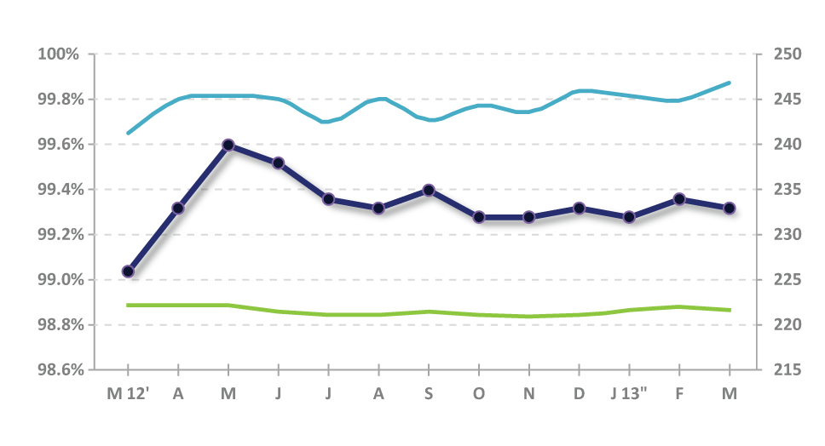

Total Technology Operation Services Service Level Agreement Quality Indicators (233)
Total Technology Indicators
240
238
234
235
234
% of Indicator Standard / Performance
233
233
232
232
233
232
233
No. of Indicators
226
Avg. Indicator Standard
Avg. Indicator Performance
No. of Indicators

Slide 44
Priority 1 Incident Review
Priority 1 Incident Resolution Time Performance
Priority Incident Service Level Agreement requires incidents to be resolved within 4 hours, 90% of the time.
Priority 1 SLA resolution time does not include incident time clocked prior to Priority 1 classification of the outage.
9 - Kasper
4 - Balch
4 - Terrasi
3 - Levang
2 - Solomon
2 - Witty
CLOSURE CODE | CLOCK MIN
Deployment | 83
Hardware Issue | 94
Application | 331
Security | 337
Internal (USB) Cust. Error | 339
Vendor | 895
Total | 2,079
DR | AFFECTED SVC | CLOSURE CODE | CLOCK MIN
KASPER | ATM | Deployment | 83
KASPER | ATM | Hardware Issue | 94
KASPER | ATM | Vendor | 149
KASPER | ATM | Vendor | 218
KASPER | ATM | Vendor | 255
SOLOMAN | Application | Internal (USB) Cust Error | 339
TERRASI | Application | Vendor | 48
TERRASI | Application | Vendor | 225
TERRASI | End User Comp. | Security | 337
WITTY | Monitoring | Application | 331

Slide 45



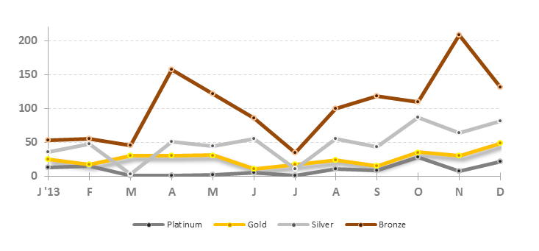
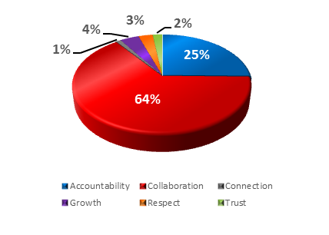
Employee Recognition
Shield Awards
YTD 2014
Aggregate 2014
eThanks Awards
eThanks Recieved
eThanks Sent
Service Values

Slide 46
Ecosystem Safeguard
Elavon
ECOSYSTEM | METRICS | DEC ‘12 | JUL ‘13 | 2013 TARGET | COMMENTS
Network | % of critical risk systems covered by monitoring | 15% | 58% | 70% | Comments
 | % of incidents with no or low business impact | 97% | 100% | 100% | Comments
Device | % of critical risk systems covered by monitoring | 15% | 58% | 70% | Comments
 | % of incidents with no or low business impact | 97% | 100% | 100% | Comments
Data | % of critical risk systems covered by monitoring | 15% | 58% | 70% | Comments
 | % of incidents with no or low business impact | 97% | 100% | 100% | Comments
Application | % of critical risk systems covered by monitoring | 15% | 58% | 70% | Comments
 | % of incidents with no or low business impact | 97% | 100% | 100% | Comments
Identity & Access Mgmt. | % of critical risk systems covered by monitoring | 15% | 58% | 70% | Comments
 | % of incidents with no or low business impact | 97% | 100% | 100% | Comments
Not available = No emergency or critical vulnerabilities

Slide 47
Key Program Inventory
SPONSORING LOB | PROGRAM | END DATE | OVERALL COST | STATUS | RECOVERY
Corp. Risk Management | Anti Money Laundering | Q1 2014 | $8.2 MM |  | Internal/vendor resource constraints. Expect recovery by end of July.
Enterprise Revenue Office | Internet Channel Technology Refresh | Q2 2014 | $146.0 MM |  | Late delivery of internal code. Expect recovery by mid July.
TOS | Payment Processing Portal (P3) | Q4 2013 | $49.9 MM |  | Vendor delivery delays. Implementation delay impact of 2 months.
Status Indication
Program Name
Sub Bullet
Sub Bullet
Bullet
Sub Bullet
Bullet
Sub Bullet

Slide 48






Spotlight: <TOPIC NAME>
Subtitle
<OBJECTIVE:>
Current Status
<INSERT SUMMARY TEXT HERE, >
<EXAMPLE 1: DATA GOVERNANCE:>
EXAMPLE 1: Data Governance is an emerging discipline that embodies a convergence of data quality, data management, data policies, business process management, and risk management surrounding the handling of data in an organization. Data Governance at US Bank will exercise positive control over the processes and methods used by data stewards and data custodians to manage data to meet the needs of the business. Data Governance is Not about DATA, it is about the People, Policies, and Processes to “manage data as an asset.”
Issues
Sub Bullet
Sub Bullet
Key Accomplishments
Risks / Areas of Concern
Key Milestones
Bullet
Bullet
Sub Bullet
Sub Bullet
Bullet
Sub Bullet
Sub Bullet Highlight
Bullet
Bullet
Sub Bullet
Sub Bullet
Bullet
Sub Bullet
Sub Bullet Highlight
<Milestone>
<DELIVERABLE / EXPLANATION>
MM/DD/YY
<Milestone>
<DELIVERABLE / EXPLANATION>
MM/DD/YY

Slide 49
Appendix

